Slide 1

Interaction in Augmented and Virtual Reality
Franz J. Kurfess
Professor
Computer Science Department
California Polytechnic State University
San Luis Obispo, CA, U.S.A.
fkurfess@calpoly.edu

Slide 2
Chapter Overview Interaction in Augmented and Virtual Reality
Motivation
Objectives
Terminology
AR, VR
mixed reality
Background
AR/VR Technology
Reality vs. Virtuality
grounding
observation
manipulation
Information Representation for AR & VR
dimensions
Diminished Reality
removal of (partial) percepts
Important Concepts and Terms
Chapter Summary

Slide 3
Motivation

Slide 4
Objectives

Slide 5
Evaluation Criteria

Slide 6
Pre-Test
Notes:
find out about the background of the participants
establish formal prerequisites
sensitize participants to potential gaps in their background knowledge
affirm the students’ qualifications

Slide 7
Augmented Reality & Information Presentation
relation virtual information - physical environment
temporality
dimensionality
frame of reference
mounting/registration
type of reference

Slide 8
Terminology
Virtual Reality
sensory perception delivered from computational devices
computational devices replace aspects of the real-world environment
participant is situated in a (partially) virtual world
Augmented Reality
computational devices provide supplementary information
superimposed on the real-world environment
Mixed Reality
intermingling of physical world and virtual world
Diminished Reality
partial percepts of the real world are removed from the user’s input

Slide 9
Background
History
Current Technology

Slide 10
VR/AR History

Slide 11
VR/AR Technology
Oculus Rift
DK 1
DK2
Consumer Version
Quest
HTC Vive
Version 1
Version 2
Google Glass
Version 1
Version 2??
MS Hololens
Version 1
2019: Version 2
Apple Vision Pro

Slide 12
Virtual and Augmented Reality
a virtual world co-exists and is enmeshed with the real (physical) world
both worlds have
3D existence
geometric and photometric properties
dynamic evolvement over times
relationships between the two worlds
one world influences or adapts to the other
may be one-way or mutual
both worlds should be reasonably consistent
may be subjective: from the user’s perspective
human involvement
closes interaction loop
interpretation of the relationships between the two worlds
initiates and manipulates interaction

Slide 13
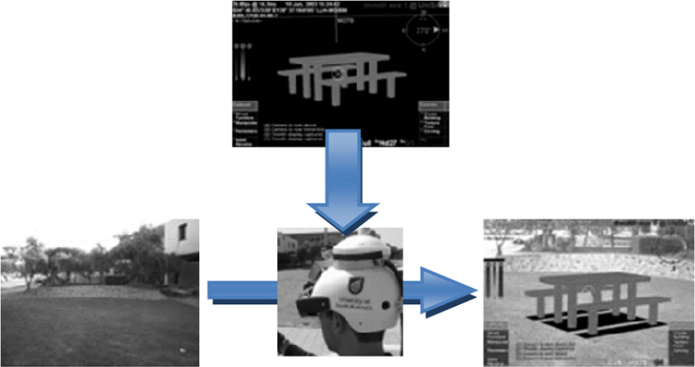
Early Augmented Reality System
Y. Ariyana and A. I. Wuryandari, 2013
Y. Ariyana and A. I. Wuryandari, 2013
Y. Ariyana and A. I. Wuryandari, 2013

Slide 14
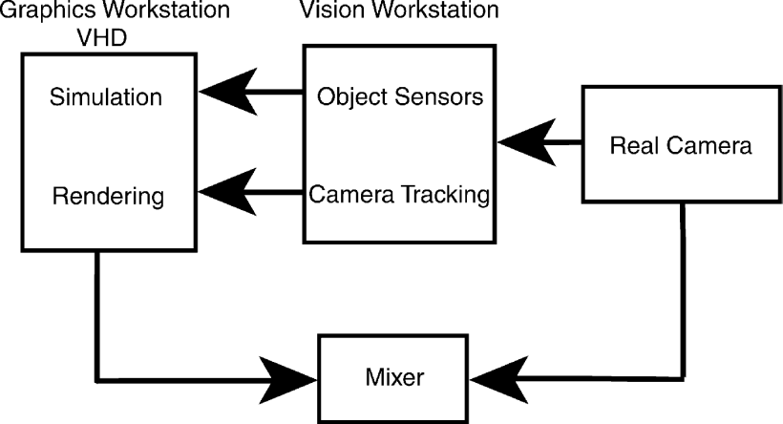
AR System Overview
Y. Ariyana and A. I. Wuryandari, 2013

Slide 15
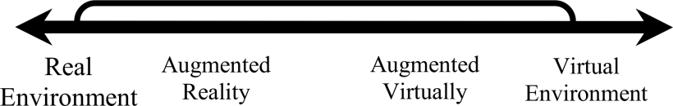
Reality <-> Virtuality
Continuum: Environment
Real
Environment
Augmented
Reality
Virtual
Reality
augmentation of the real environment through computational capabilities
extreme case: completely virtual, no connection to the real world
computational activities ultimately must happen in the real world
execution of a program on a physical computer
computing as “substrate” for a virtual environment
Y. Ariyana and A. I. Wuryandari, 2013

Slide 16
Reality <-> Virtuality
Continuum: Agent
human as embodied agent
exists and acts in the real world
human as situated agent
exists and acts in a specific environment
often a physical environment
may be a virtual environment for software agents
human as augmented agent
additional capabilities, such as sensors, actuators, computing powers
human as virtual agent
avatar as a proxy of a human in a virtual environment
Y. Ariyana and A. I. Wuryandari, 2013

Slide 17
Reality vs. Virtuality
Observation (passive)
reality is (partially) directly observable with human senses
“hidden” aspects of reality can be revealed through additional (non-human) sensors or augmentation of human sensing capabilities
virtuality is observable only through computational intermediation
mapped onto objects in the real world
possibly generated directly in the human brain
bypassing human senses
requires direct interaction with the brain
Manipulation (active)
real-world objects can be manipulated through human actuators
mere presence may also affect the real world
virtual objects must be manipulated through computational intermediation
mapping of user actions into the virtual world

Slide 18
Grounding
for human interaction, abstract constructs often have a connection to the real world
referred to as “grounding” or “symbol grounding” in AI
AI: relationships between symbols (in a program or model) and their counterparts in the real world
AR: relationship between virtual objects and real-world objectss
strong grounding: direct connection to reality
biometrics collected by wearables
weak grounding: indirect connection to reality
abstract art
visualizations of mathematical functions
no grounding: disconnected from reality
abstract mathematical theories

Slide 19
Augmentation and Virtuality
Super-Human
Augmentation
Human
Avatar
Real
Virtuality
Virtual

Slide 20

Augmentation and Virtuality
Super-Human
Augmentation
Human
Avatar
Real
Virtuality
Virtual

Slide 21
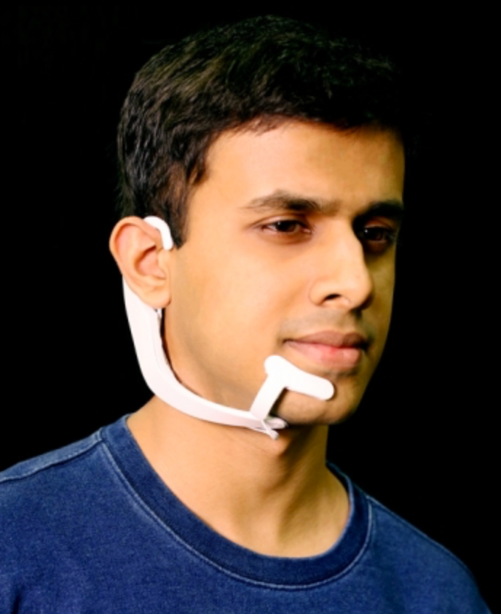



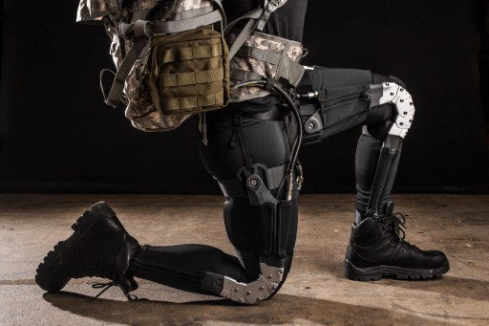


Augmentation and Virtuality
Super-Human
Augmentation
Human
Avatar
Real
Virtuality
Virtual

Slide 22
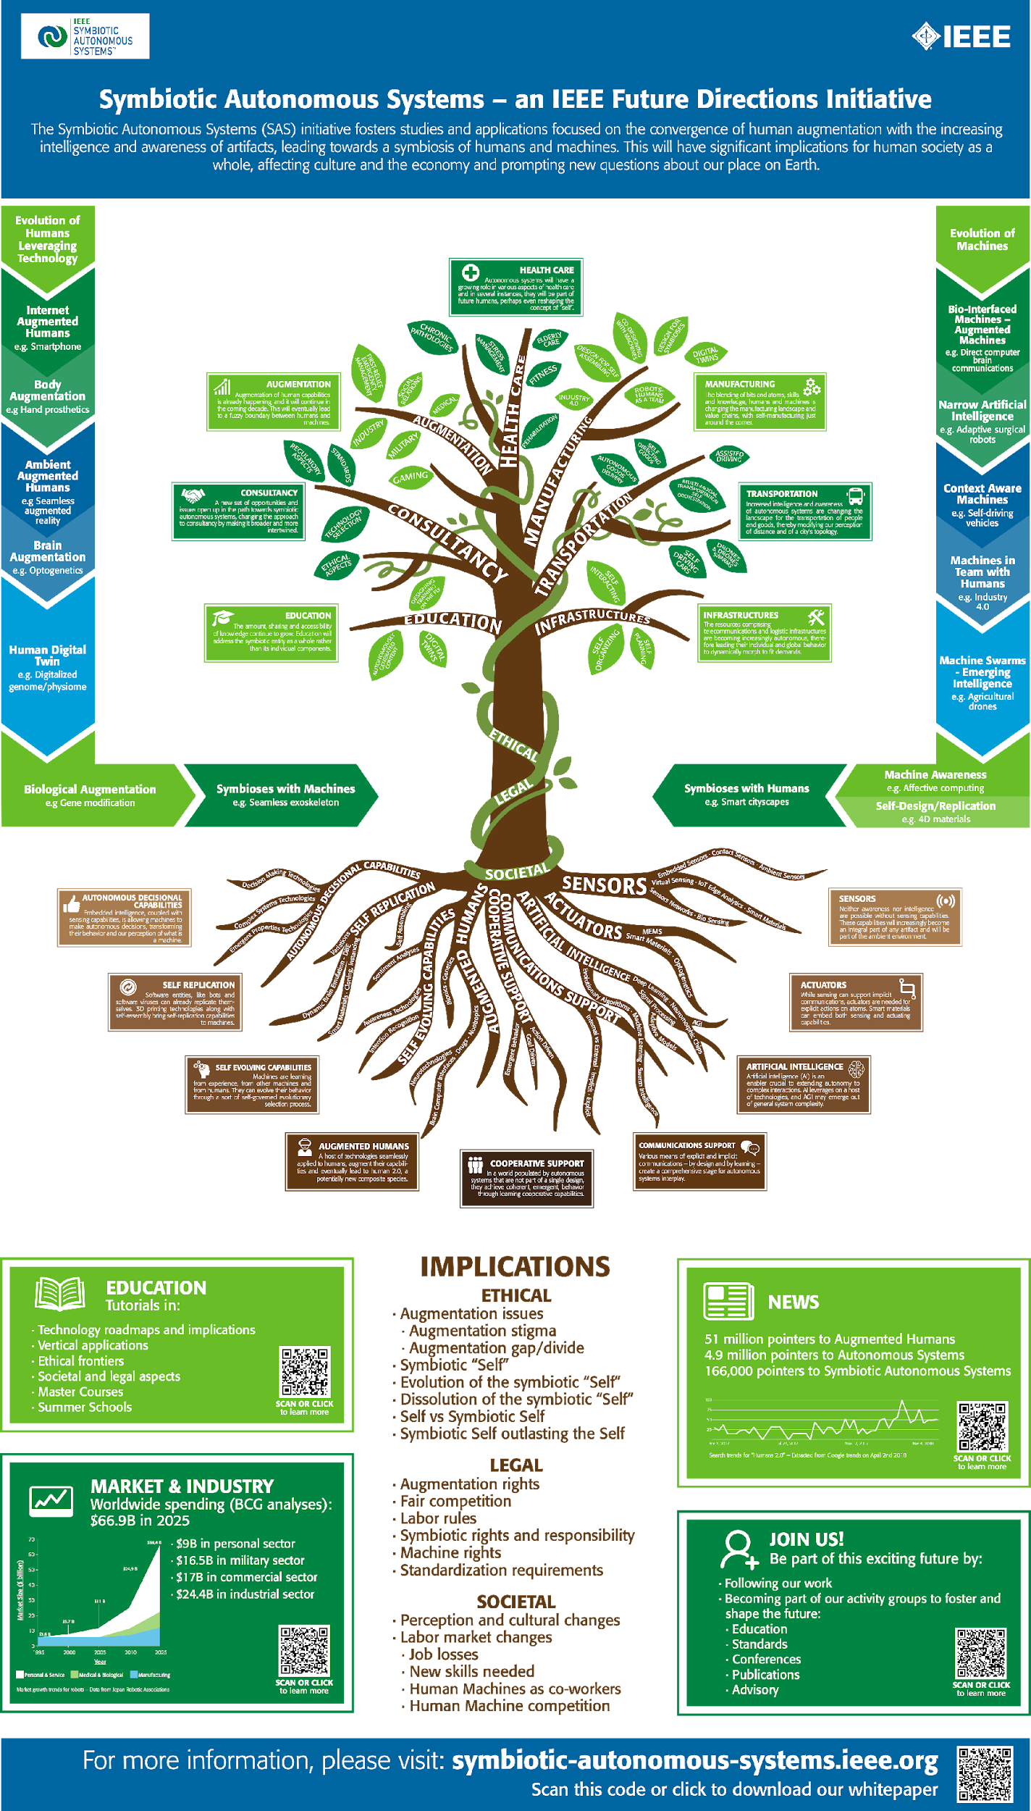
Symbiotic Autonomous Systems
Symbiotic relationships between autonomous systems
humans
computer-based systems
IEEE Symbiotic Autonomous Systems (SAS) Initiative
Take the lead in developing the new field of Symbiotic Systems Science
Foster interdisciplinary technology deployments that take into account Ethical, Legal, and Societal considerations
Promote human-centric economic growth
https://symbiotic-autonomous-systems.ieee.org/

Slide 23
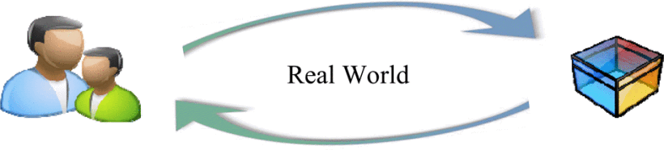
Real-World Interaction
Y. Ariyana and A. I. Wuryandari, 2013

Slide 24
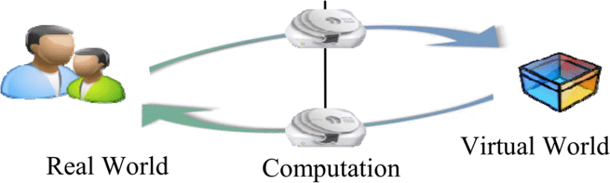
Virtual Reality Interaction
Y. Ariyana and A. I. Wuryandari, 2013

Slide 25
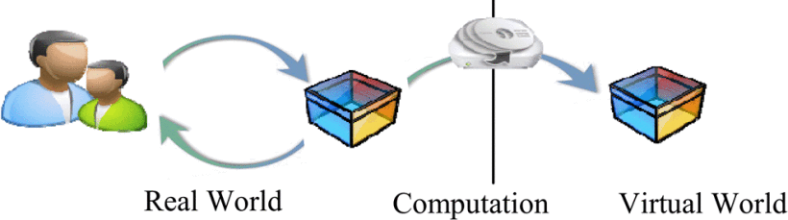
Augmented Reality Interaction
Y. Ariyana and A. I. Wuryandari, 2013

Slide 26
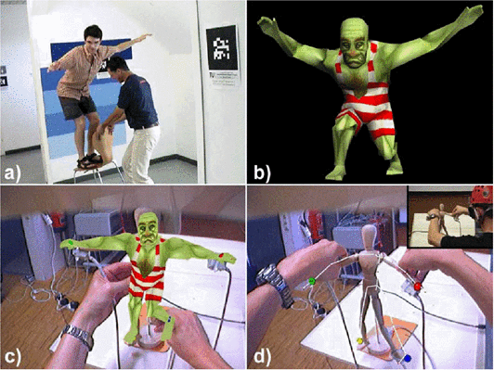
Avatar Control
Y. Ariyana and A. I. Wuryandari, 2013

Slide 27
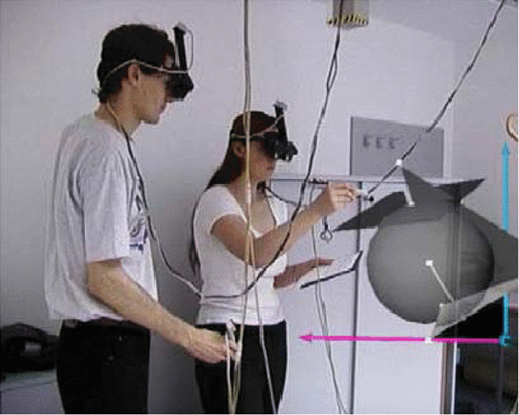
Y. Ariyana and A. I. Wuryandari, 2013

Slide 28
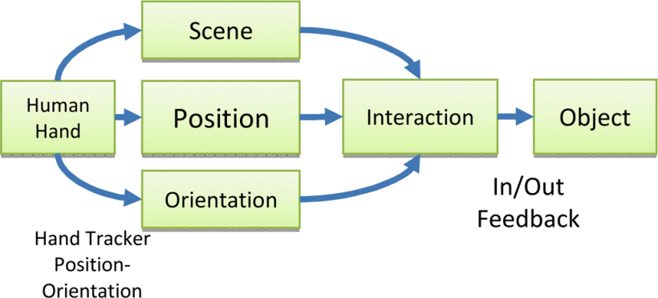
Actuator-Object Interaction
Y. Ariyana and A. I. Wuryandari, 2013

Slide 29
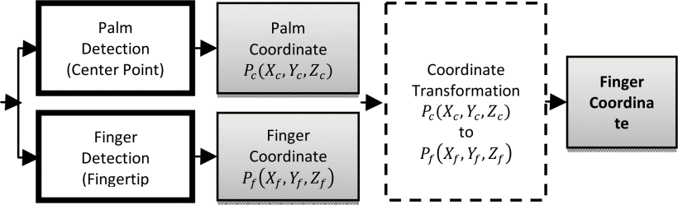
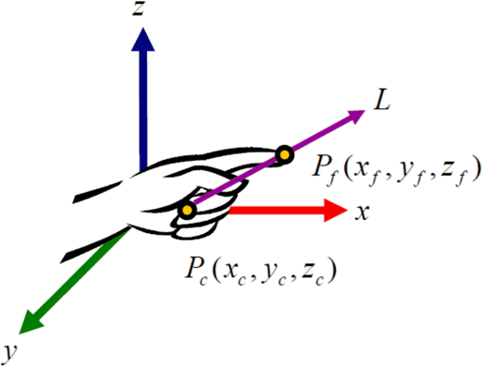
Y. Ariyana and A. I. Wuryandari, 2013

Slide 30
Dimensions of Information Representation for AR
Temporality:
continuous versus discrete representation of virtual objects.
Dimensionality:
the number of features (dimensions) that virtual and physical objects possess
methods to visualize and render them
Viewpoint reference frame:
ego-centric versus exo-centric and ego-motion-based control of viewpoints
Mounting/registration:
spatial relationships between objects
Type of reference:
concepts regarding the visibility of referred-to physical objects

Slide 31
Representation vs. Presentation
Representation
organization of information
utilizes storage principles and technologies
relies on presentation of information to make it useful for humans
Presentation
display of information
often interpreted as “visual” presentation
in principle, may use other information channels
auditory, haptic, smell, taste, …
utilizes primarily display technologies
other output technologies possible
audio, touch, smell
relies on information represented in some storage medium

Slide 32
Temporality
continuous versus discrete representation of virtual objects
persistence
duration of the presentation of objects
may be independent of their existence as internal representation
location
stationary
movable
mobile
appearance
static - doesn’t change
dynamic - changes over time

Slide 33
Dimensionality
dimensions
the number of features that virtual and physical objects possess
presentation
methods to visualize and render those features
2D
“flat” presentation often indicated as width and height
2.5D: simulation of 3D with 2D technology
3D
depth added
4D
time added
multi-dimensional
extra features of interest added
hard to visualize

Slide 34
Viewpoint Reference Frame
ego-centric
the agent is at the center of the coordinate system
other objects appear to move
natural for humans
automatic adjustment for static parts of the environment
exo-centric
there is an external coordinate system in which the agent moves
ego-motion-based control
as the agent moves, the presentation of the environment is adjusted

Slide 35
Mounting & Registration
spatial relationships between objects
Mounting
attachment of virtual objects or information units to something
Registration
efforts to determine a physical world location as a mounting spot for virtual objects
requires tracking facilities

Slide 36
Type of Reference
concepts regarding the visibility of referred-to physical objects
extent to which a virtual object refers to a physical object or location
Direct overlays and references
the physical counterpart resides in the user’s field of view
Indirect overlays and references
physical object is not visible, but lies in the field of view
Pure references
virtual object points to a physical object or location not in the field of view
virtual object represents a link between objects

Slide 37
Diminished Reality
AR methods are used to hide or obscure real-world elements
noticeable: observer is made aware of changes
discreet: removed elements are replaced by elements that fit in the overall context

Slide 38
Examples Diminished Reality
visual & graphics
removal of objects from text, photo, video, real-time displays
blacking out to hide information in text documents
blurring of nudity on TV
filters in image editing tools
audio
noise-cancelling headphones
“bleeping” of swear words in audio

Slide 39
Fake Reality?
elements from the real world are rearranged into a credible appearance of events that did not happen
“photoshopping” of images
“deep fakes” - deep learning to generate fake videos from existing footage
Autotune for singers

Slide 40
References
Marcus Tönnis, David A. Plecher, and Gudrun Klinker. 2013. Survey Representing information - Classifying the Augmented Reality presentation space. Comput. Graph. 37, 8 (December 2013), 997-1011. DOI=10.1016/j.cag.2013.09.002 http://dx.doi.org/10.1016/j.cag.2013.09.002
Y. Ariyana and A. I. Wuryandari, "Basic 3D interaction techniques in Augmented Reality," 2012 International Conference on System Engineering and Technology (ICSET), Bandung, 2012, pp. 1-6. doi: 10.1109/ICSEngT.2012.6339281

Slide 41
Evaluation

Slide 42
Important Concepts and Terms

Slide 43
Chapter Summary

